Slide 1
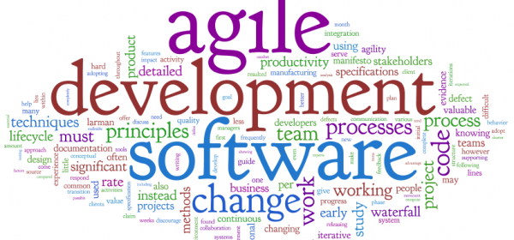
Ensuring Agile Success
- Prof K G Krishna

Slide 2



Text/Reference Books
T1
T2
Compliments of IBM
➔ As this field is evolutionary, the student is advised to stay tuned to the current and emerging practices by referring to their own organization’s documentation as well as Net sources

Slide 3
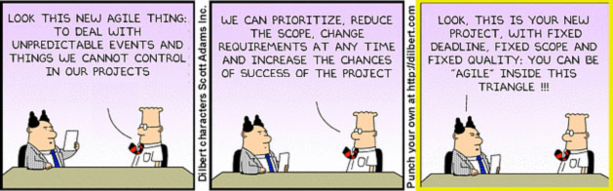
Topics
Ensuring Agile Success
Managing Change
Agile Success Factors
Agile Evolving with Times

Slide 4
10 Key Factors for Agile Success
Dedicated Team Members (“Task switching wastes 40% of time”)
Team members should be dedicated — product owner, development team members, as well as scrum master — to a single project at a time
Collocation
The Agile Manifesto lists individuals and interactions as the first value. The way you get this value right is by collocating team members to be able to have clear, effective, and direct communication throughout a project.
Automated Testing
Development teams cannot develop at the rate technology and market conditions change if they have to manually test their work every time they integrate new pieces of functionality throughout the sprint.
Enforced Definition of Done
Ending sprints with non-shippable functionality is an anti-pattern to becoming more agile. Your definition of done should clarify the following: The environment in which the functionality should be integrated; The types of testing; The types of required documentation
Clear Product Vision and Roadmap (“The best requirements, and designs emerge from self-organizing teams”)
Product owner owns the Product Vision and Roadmap; however, ownership is with all the members;
Product Owner Empowerment (The product owner’s role is to optimize the value produced by the development team)
Developer Versatility
Scrum Master Clout (empowered Scrum Master to work with leadership of the organization)
Scrum master empowered by leadership to work with members of the scrum team, stakeholders, and other third parties to remove roadblocks
Management Support for Learning
Transition Support
Coaching at leadership and team levels increases chances to succeed (training, one-on-one mentoring for specific role-based challenges)

Slide 5
Getting Commitment to Agile Transition
Identify an Agile Champion: a senior-level manager or executive who can help ensure organizational change; the fundamental process changes that accompany agile transitions require support from the people who make and enforce business decisions and a good agile champion is able to rally the organization and its people around process changes.
Identify Problems that can be best be solved using Agile Methods: Illustrate how Agile can provide greater benefits by addressing the existing issues in the current projects:
Profit benefits: Agile approaches allow project teams to deliver products to market quicker than with traditional approaches. Agile organizations can realize higher return on investment.
Defect reduction: Quality is a key part of agile approaches. Proactive quality measures, continuous integration and testing, and continuous improvement all contribute to higher-quality products.
Improved morale: Agile practices such as sustainable development and self-managing development teams can mean happier employees, improved efficiency, and less company turnover.
Happier customers: Agile projects often have higher customer satisfaction because agile project teams produce working products quickly, can respond to change, and collaborate with customers as partners.

Slide 6
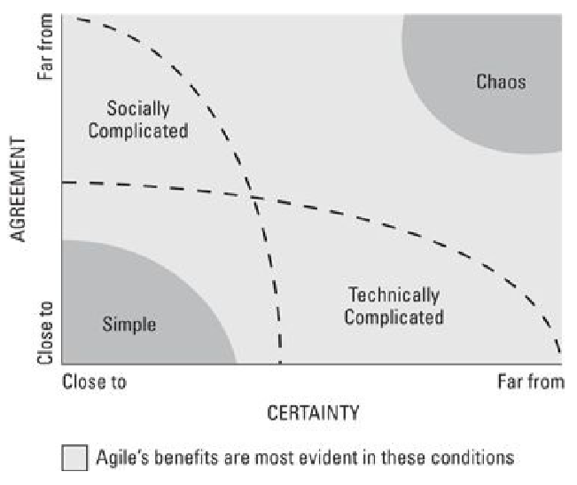
Projects that can benefit from going Agile
Source: (T2-Chap17)

Slide 7
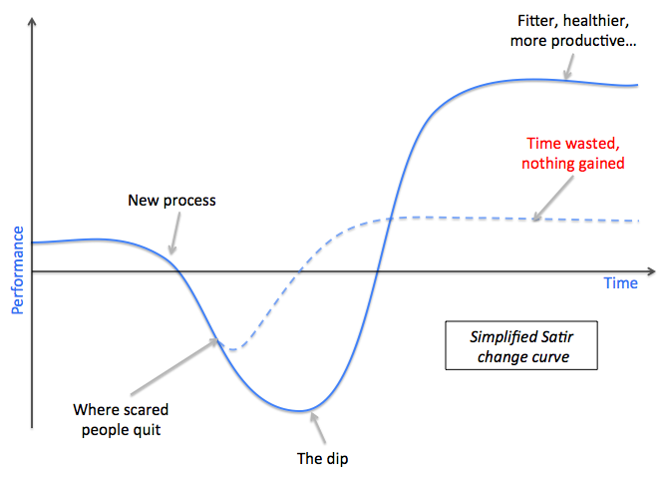
“Change is not Smooth” (Satir’s Curve)
Source: (T2-Chap17)

Slide 8
Managing Change (12 Steps)
Conduct Implementation Strategy by Identifying: Success Factors; Current Process vs. Agile Methodology; Step-by-Step Plan to implement Agile; Benefits and Challenges;
Establish a Transformation Team: Responsible for Agile transformation at the organization level (a Champion with Management Support); Focus on areas of Change for Agile Transformation
Build Awareness and Excitement: Educate people across the organization on the benefits of Agile through wide communication via newsletters, town-hall meetings and encouraging pioneers, etc.
Identify a Pilot Project: Select a small project which is important, visible, clear and containable and measurable
Identify Success Metrics: Rate of Sprint Goal success, No. of defects, Responding to change, Income generation potential, Customer satisfaction, Stakeholder Happiness,…
Train Sufficiently: Training by an Agile coach in a face-to-face workshop setting, work-exercises based on real-life challenges
Develop a Product Strategy: Start with Product Vision and Roadmap exercise
Develop Product Roadmap, Product Backlog, Sprint Backlog and Estimates
Run the First Sprint
Gather Feedback, Analyze and Improve
Maturity by Constant Inspection and Adpatation
Scale Vertically by creating Evangelists / Agile Ambassadors

Slide 9
Agile Success Metrics
How often did the scrum team meet sprint goals? Did the rate of sprint goal success rise throughout the project?
Did the number of defects in each sprint decrease throughout the project? How much time lapsed between finding and fixing defects?
How soon was the scrum team able to release a valuable product to the marketplace? How often did the scrum team provide valuable updates?
If the product generated income, when did the first dollar come in? What was the overall return on investment?
How did the agile project time to market and return on investment compare with that of past projects using the company’s old methodologies?
Is the customer happy? Are stakeholders happy? Did customer and/or stakeholder satisfaction increase throughout the project?
Did scrum team member satisfaction increase throughout the project? What other types of metrics does your organization value?
Can your project demonstrate any specific company goals?

Slide 10
Agile is an Attitude, Not a Technique…
“Agile…is an attitude, not a technique with boundaries. An attitude has no boundaries, so we wouldn’t ask ‘can I use agile here’, but rather ‘how would I act in the agile way here?’ or ‘how agile can we be, here?’”
- Alistair Cockburn (Agile Guru)

Slide 11

Evolution of Agile with the Times ➔➔

Slide 12
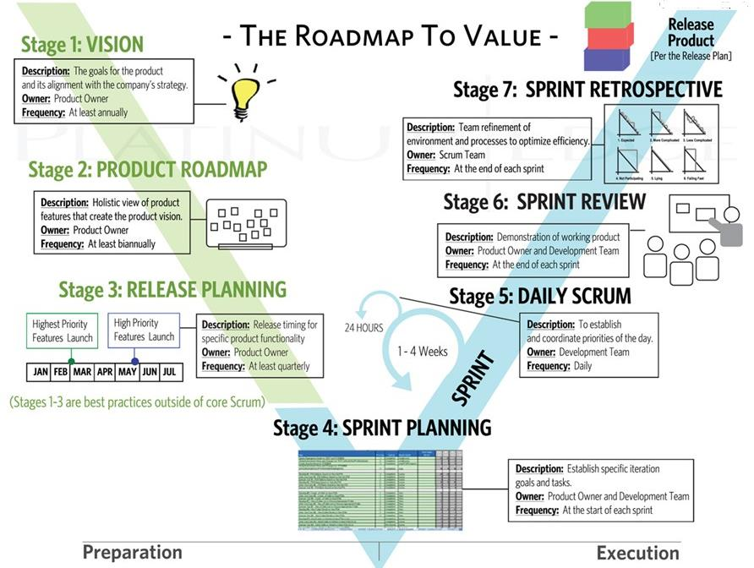
Agile is a Natural Evolution towards Survival in this Digital Era, and Scrum is just the Beginning…
Source: (T2)

Slide 13
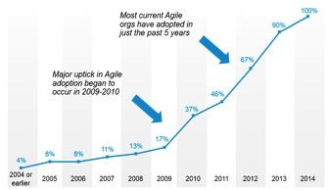
Agile Adoption in Recent Years…
Source: Tech Beacon

Slide 14
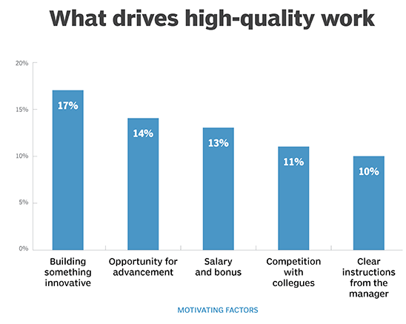
Agile-driven Transformations
Agile + DevOps ➔ AgileDevOps
(Development + Operations) /w Daily build (CI) = DevOps
Evolving with Cloud, Mobile Infrastructure & SoA (Microservices Architecture)
Infrastructure + Programming Frameworks ➔ Containerized Apps (infrastructure independent development/deployment on Cloud)
Code heavy Development ➔ Low-code/No-code Platforms/API/Microservices-driven development frameworks
Agile Software Processes ➔ Agile Methods in any Product Development
Transformation of Organization Structures: Top-down, Hierarchical and Networked Structures ➔ Self-organizing Empowered Agile Teams
Agile is the language of Startups who dream game-changing products and services in this digital era
Source: 2017 Survey of 5000 Development Professionals by CAST

Slide 15
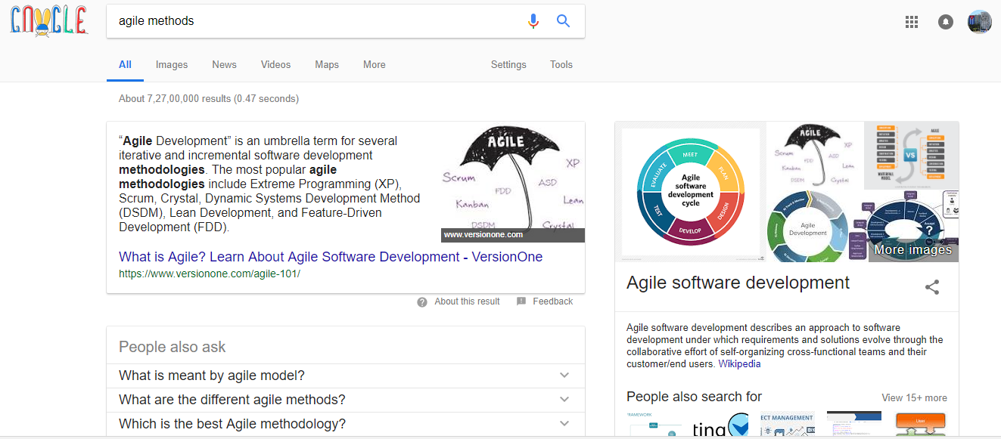
Let’s “Google-walk” the Agile

Slide 16
Summary: Ensuring Agile Success
Transform Organizational Culture towards Agile Teams (micromanaging → self-managing teams)
Managing Change with a dedicated Agile Champion (Agile Coach) for driving transformation with communication and training
Start with identifying a Simple Lighthouse Project as a ripe candidate for going Agile
In these times of rapid digital transformation, evolve Agile Practices in tune with technology/business trends
Let’s look forward to the day when the words ‘Agile’ and ‘Customer Orientation’ would disappear or get subsumed the way of ‘Quality’ and ‘Management’ in Organizational Vocabulary !!!!

Slide 17
Thank You
© Copyrights of original Authors are duly acknowledged
™ ® All Trademarks, Registered Trademarks referred in this document are the property of their respective owners

